Slide 1
Laravel API
Course Code: CSC 4182
Course Title: Advanced Programming In Web Technologies
Dept. of Computer Science
Faculty of Science and Technology
Lecturer No: | 2 | Week No: | 01 | Semester: | Summer20-21
Lecturer: | Md.Al-Amin (alamin@aiub.edu)

Slide 2
Lecture Outline
API
Type of APIs
SOAP vs RESTfull
Laravel API

Slide 3
Lecture Objective
Understanding & practicing API
Application Programming Interface (API)

Slide 4
Application Programming Interface (API)
According to Wikipedia: An application programming interface (API) is a computing interface to a software component or a system, that defines how other components or systems can use it. It defines the kinds of calls or requests that can be made, how to make them, the data formats that should be used, the conventions to follow, etc. It can also provide extension mechanisms so that users can extend existing functionality in various ways and to varying degrees.

Slide 5
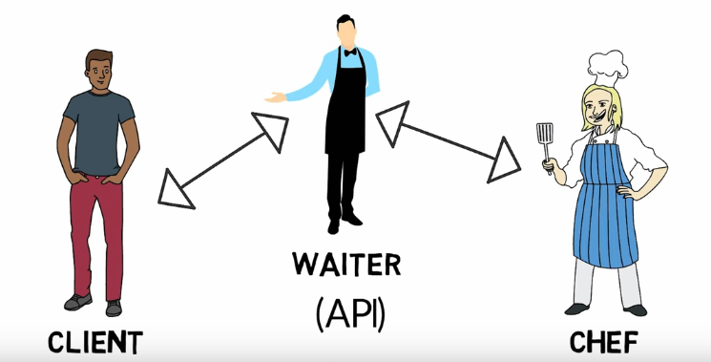
What is API?
Application Programming Interface (API):
A software interface used to access data, server software or other application

Slide 6
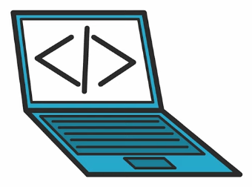
Usage of API
Web based systems
Operating systems
Database systems
Computer hardware
Good API = Easier Programming + Faster Integration + Scalable

Slide 7
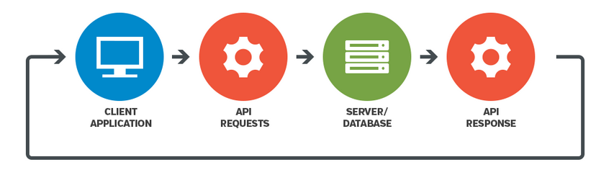
How API works

Slide 8
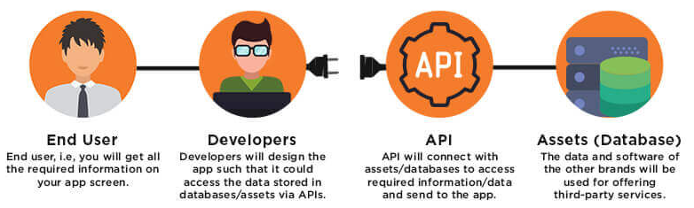
How API works

Slide 9
Types of API
REST (RESTful) API
Representational state transfer JSON format
SOAP
Simple Object Access Protocol uses XML to transfer data
XML-RPC
Extensible Markup Language
Remote Procedure Calls
JSON-RPC
JSON instead of XML format

Slide 10
REST API vs SOAP API
# | Key | REST API | SOAP API
1 | Implementation | Rest API is implemented as it has no official standard at all because it is an architectural style. | On other hand SOAP API has an official standard because it is a protocol.
2 | Internal communication | REST APIs uses multiple standards like HTTP, JSON, URL, and XML for data communication and transfer. | SOAP APIs is largely based and uses only HTTP and XML.
3 | Resource requirement | As REST API deploys and uses multiple standards as stated above, so it takes fewer resources and bandwidth as compared to SOAP API. | On other hand Soap API requires more resource and bandwidth as it needs to convert the data in XML which increases its payload and results in the large sized file.
4 | Description | REST API uses Web Application Description Language for describing the functionalities being offered by web services. | On other hand SOAP API used Web Services Description language for the same.

Slide 11
REST API vs SOAP API
# | Key | REST API | SOAP API
5 | Security | REST has SSL and HTTPS for security. | On other hand SOAP has SSL( Secure Socket Layer) and WS-security due to which in the cases like Bank Account Password, Card Number, etc. SOAP is preferred over REST.
6 | Abbreviation | REST stands for Representational State Transfer. | On other hand SOAP stands for Simple Object Access Protocol
7 | Interchange | REST can make use of SOAP as the underlying protocol for web services, because in the end it is just an architectural pattern. | On other hand SOAP cannot make use of REST since SOAP is a protocol and REST is an architectural pattern.

Slide 12
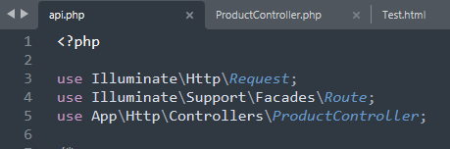
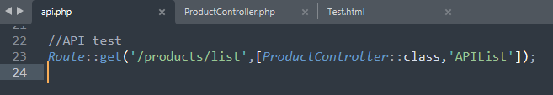
API in Laravel (get data)
Laravel can create and handle API very easily.
API routes can be found in routes/api.php
Include the controller in api.php
Create route in api.php

Slide 13
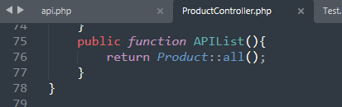
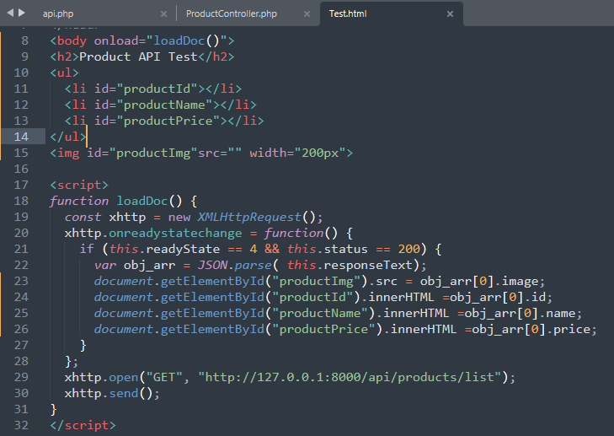
API in Laravel (get data)
Return data from controller
Get data from the database to the view

Slide 14
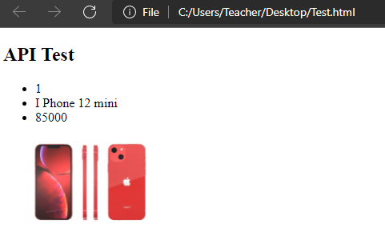
API in Laravel (get data)
Request data from the web and render

Slide 15

Postman
Postman is an application used for API testing. It is an HTTP client that tests HTTP requests, utilizing a graphical user interface, through which we obtain different types of responses that need to be subsequently validated.

Slide 16
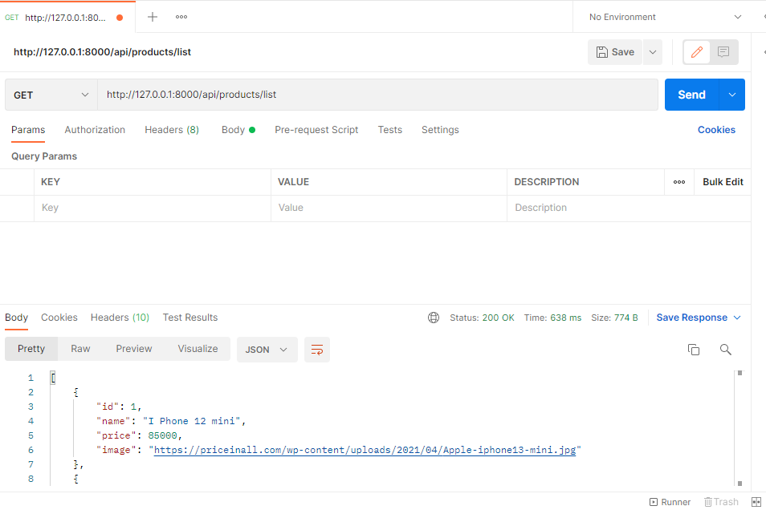
Test Postman (GET)
Request data using Postman
Data will be returned from database

Slide 17
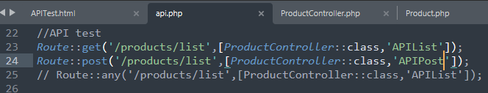
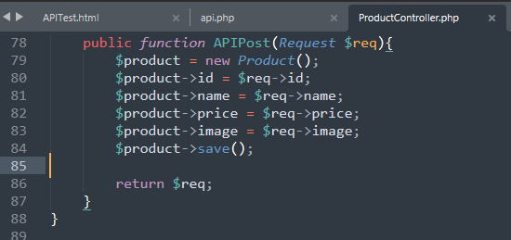
API in Laravel (post data)
Add route in api.php
Insert data using controller

Slide 18
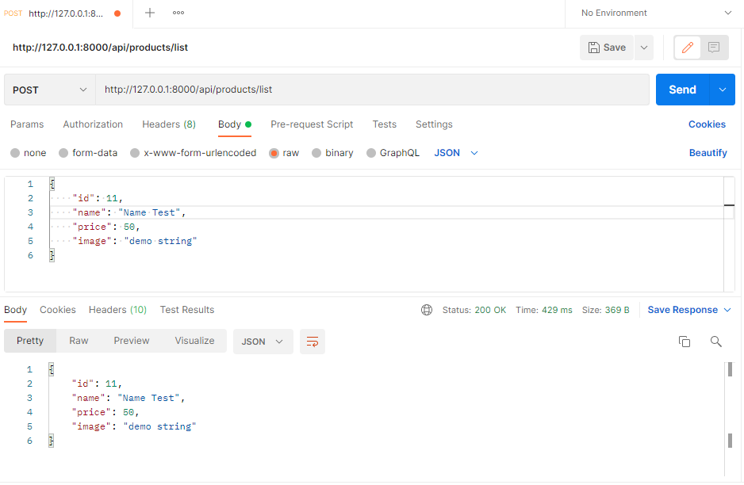
Test Postman (POST)
Insert data from Postman
Database will be updated

Slide 19
Books
PHP Advanced and Object-Oriented Programming, 3rd Edition; Larry Ullman; Peachpit, Press, 2013
PHP Objects, Patterns and Practice, 5th Edition; Matt Zandstra; Apress, 2016
Learning PHP, MySQL, JavaScript and CSS, 2nd Edition; Robin Nixon; O’Reilly, 2009
Eloquent JavaScript: A Modern Introduction to Programming; Marijn Haverbeke; 2011
Learning Node.js: A Hands On Guide to Building Web Applications in JavaScript; Marc Wandschneider; Addison-Wesley, 2013
Beginning Node.js; Basarat Ali Syed; Apress, 2014

Slide 20
References
https://www.w3schools.com/js/default.asp
https://www.tutorialspoint.com/javascript/index.htm
https://stackoverflow.com/questions/20435653/what-is-vanillajs
http://www.cs.ucc.ie/~gavin/javascript/
https://www.w3schools.com/js/default.asp

Slide 21
Thank You!

